Slide 1

PRM1003 - Project Cost Management
Module 1 – Cost Management Plan
Notes:
1

Slide 2
Project Cost Management
Objectives
At the end of this course, you should be able to:
Explain the inputs and outputs for project cost management
Demonstrate the ability to use cost management tools and techniques
Demonstrate the ability to measure and report on costs
Explain the importance of measuring tools
Notes:
2
2

Slide 3
Project Cost Management
Introduction
Project Cost Management
Project Cost Management includes the processes involved in planning, estimating, budgeting, financing, funding, managing and controlling costs so that the project can be completed within the approved budget
Plan cost management
Estimate costs
Determine budget
Control cost
Notes:
3
3

Slide 4
Project Cost Management
Introduction
Cost management is predicting and analyzing the prospective financial performance of the project’s product
Can be done inside or outside the project
When included, Project Cost Management will address additional processes and numerous general management techniques such as:
Revenue Recognition – Accrual (Video)
SOX – Sarbanes Oxley (PDF Document)
POC Impact – Percent of Completion
Notes:
4
4

Slide 5
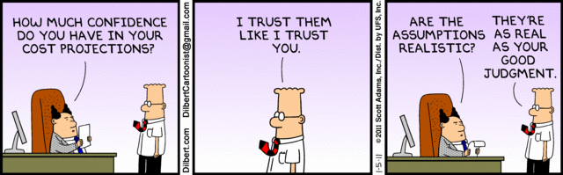
Project Cost Management
Introduction
Managing Project Costs
DILBERT by Scott Adams
Notes:
5
5

Slide 6
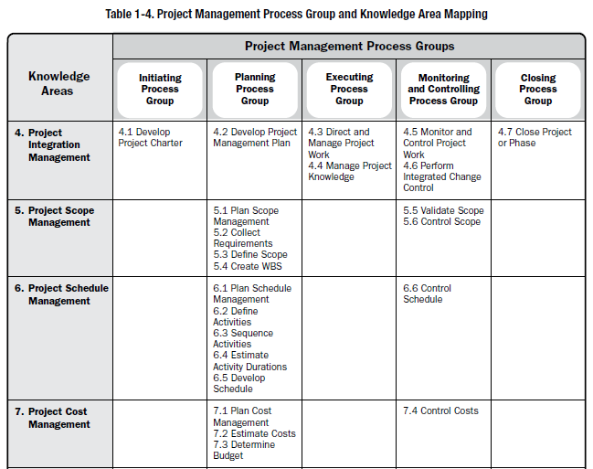
Project Cost Management
Project Management Lifecycle
PMBOK® Guide, 5th Edition, Table 3-1, p. 61
Notes:
6
6

Slide 7
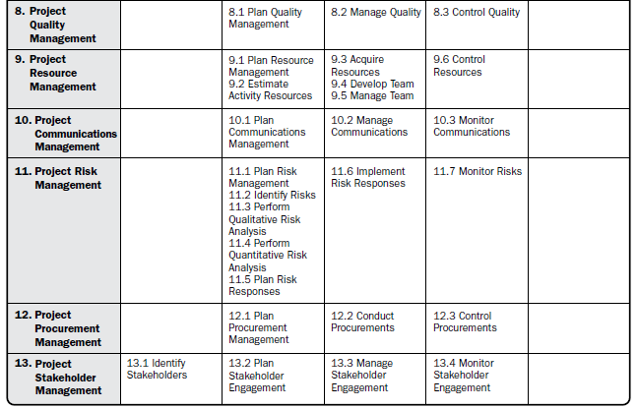
Project Cost Management
Project Management Lifecycle (Continued)
PMBOK® Guide, 5th Edition, Table 3-1, p. 61
Notes:
7
7

Slide 8
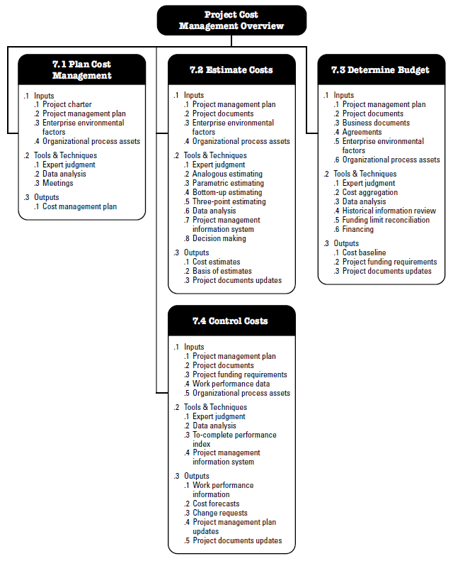
Project Cost Management
Processes
PMBOK® Guide, 6th Edition, Figure 7-1, p. 232
Notes:
8
8

Slide 9
Project Cost Management
Plan Cost Management
The process that establishes the policies, procedures and documentation for planning, managing, expending and controlling project costs
Key Benefit
It provides guidance and direction on how the project costs will be managed throughout the project
Notes:
9
9

Slide 10
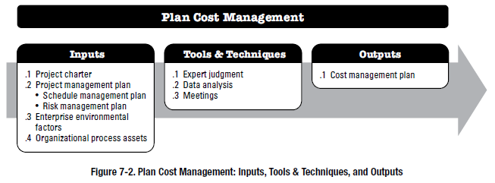
Project Cost Management
Process
Plan Cost Management
PMBOK® Guide, 6th Edition, Figure 7-2, p. 235
Notes:
10
10

Slide 11
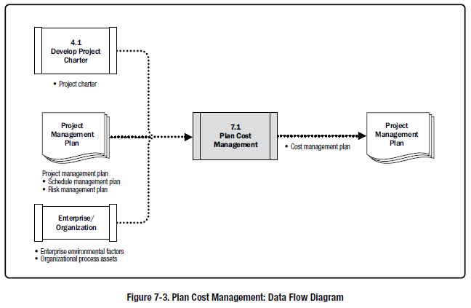
Project Cost Management
Process
Plan Cost Management
PMBOK® Guide, 6th Edition, Figure 7-3, p. 235
Notes:
11
11

Slide 12
Project Cost Management
Input
Project Charter
The project charter provides a common understanding of:
Project purpose;
Measureable project objectives;
Project purpose;
High-level requirements;
High-level project description, and key deliverables;
Overall project risk;
Summary milestone schedule;
Preapproved financial resources;
Key stakeholder list;
Project approval requirements
Project exit criteria
Assigned project manager, responsibility, and authority level; and
Name and authority of the sponsor or other person(s) authorizing the project charter.
PMBOK® Guide, 6th Edition, p. 81
Notes:
12
12

Slide 13
Project Cost Management
Input
Project Management Plan
Primarily focused on the
Scope Baseline
Project Scope Statement
Work Breakdown Structure (WBS)
WBS Dictionary
Schedule Baseline
Allows determination of when project cost will be incurred
Other Information
Scheduling decisions
Risk decisions
Communication decisions
Notes:
13
13
Flows into triple constraint discussion on the next slide.

Slide 14
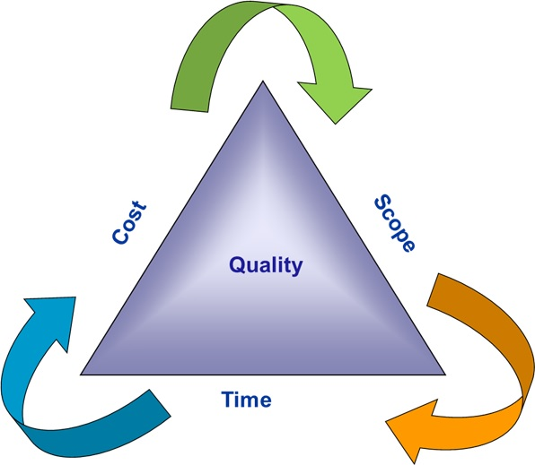
Project Cost Management
Input
Triple Constraint of Project Management
“The Iron Triangle”
Notes:
14
14

Slide 15
Project Cost Management
Input
Enterprise Environmental Factors
Typically, these are
Organizational culture and structure
Market conditions
Availability of products, services and results in the regional and global markets
Currency exchange rates
Resources sourced from more than one country
Published commercial information
Resource cost rates by region
Human resource and skill assessments by region
Seller’s price lists
PMIS
Notes:
15
15

Slide 16
Project Cost Management
Input
Organizational Process Assets
Typically, these are
Financial controls
Historical information and lessons learned knowledge bases
Financial databases
Cost estimating and budget related policies, procedures and guidelines
Notes:
16
16

Slide 17

Project Cost Management
Outputs
Cost Management Plan
A component of a project or program management plan that describes how costs will be planned, structured, and controlled
PMBOK® Guide, 5th Edition, PMI Glossary
Notes:
17
17

Slide 18
Project Cost Management
Outputs
Cost Management Plan
Typically establishes
Units of measure
Level of precision
Level of accuracy
Organizational procedure links
Control thresholds
Rules of performance measurement
Reporting formats
Process descriptions
Strategic funding choices
Procedures to handle fluctuations in currency exchange rate, inflation
Procedures for project cost reporting
Notes:
18
18

Slide 19
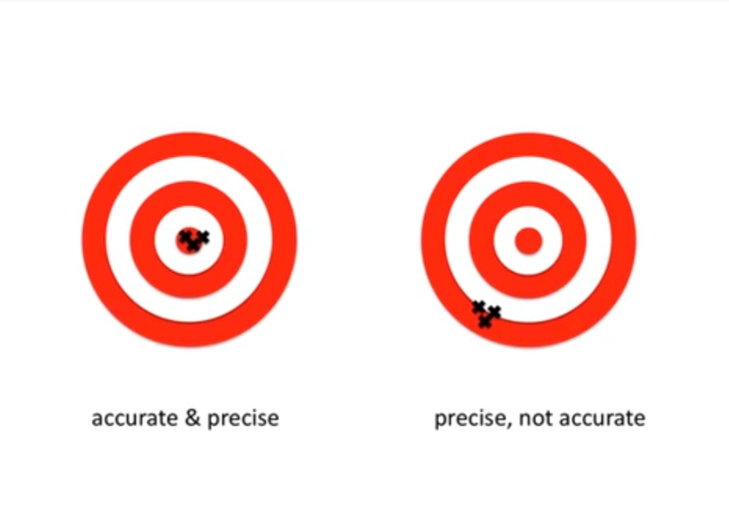
Plan Cost Management
Outputs
Accuracy vs. Precision
Notes:
19
19

Slide 20
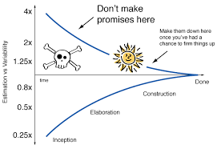
Project Cost Management
Outputs
Managing Project Costs: Cone of Uncertainty
Notes:
20
20

Slide 21
Project Cost Management
Earned Schedule
EMERGING PRACTICES – Earned Schedule (ES)
ES is an extension to the theory and practice of EVM.
Earned schedule theory replaces the schedule variance measures used in traditional EVM (earned value − planned value) with ES and actual time (AT).
Using the alternate equation for calculating schedule variance ES − AT, if the amount of earned schedule is greater than 0, then the project is considered ahead of schedule. In other words, the project earned more than planned at a given point in time.

Slide 22
Project Cost Management
Earned Schedule
Earned Schedule (Continued)
The schedule performance index (SPI) using earned schedule metrics is ES/AT.
This indicates the efficiency with which work is being accomplished.
Earned schedule theory also provides formulas for forecasting the project completion date, using earned schedule, actual time, and estimated duration.

Slide 23
Project Cost Management
Assumptions
Assumptions
Information that is required to plan your project, but is unavailable currently.
Assumptions are accepted as true often without proof.
Assumptions should be validated.
Please watch video on creating the assumption log.

Slide 24

In-Class Case Study: Lofted Barn
Project Cost Management
Introduction
https://www.oldhickorybuildings.com/products
Notes:
24
24

